Slide 1
Enron Investigation Project
Submitted in the partial fulfillment for the award of the degree of
BACHELOR OF ENGINEERING
IN
Artificial Intelligence and Machine Learning
Submitted by:
Yamini – 20BCS6766
Mayank - 20BCS6788
Saumya Dua – 20BCS5746
Under the Supervision of:
Ms. Shaveta Jain
Department of AIT-CSE
DISCOVER . LEARN . EMPOWER

Slide 2
Outline
Introduction to Project
Problem Formulation
Objectives of the work
Methodology used
Results and Outputs
Conclusion
Future Scope
References

Slide 3
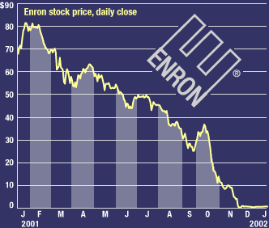
Introduction to Project
The Enron scandal was a case of corporate fraud and accounting malpractice that involved Enron Corporation, one of the largest energy companies in the United States. The scandal resulted in the bankruptcy of Enron, the conviction of several of its top executives, and significant financial losses for investors and employees.The goal is to use ML techniques to uncover any evidence of wrongdoing by Enron executives or employees and to help hold them accountable for their actions.

Slide 4

Problem Formulation
The problem formulation for investigating the Enron scandal using machine learning (ML) can be stated as follows. Given the financial data and email communications from Enron's archives and other sources, the goal is to develop ML models that can detect patterns and anomalies that suggest fraud or other forms of financial malpractice. The ML models should be able to accurately and efficiently identify cases of fraud, and should prioritize explainability and transparency to ensure that the findings are trustworthy and actionable.

Slide 5
Objectives of the Work
The objectives of investigating the Enron scandal using machine learning (ML) include:
Identify potential cases of fraud and financial malpractice.
Extract insights from Enron email dataset.
Develop explainable and transparent ML models.
Build a web frontend for data visualization and analysis.
Contribute to the field of ML-based fraud detection.

Slide 6
Methodology used
You can include the Flowchart/ DFDs describing the workflow and modules of your project.
2-3 slides to be used.

Slide 7
Results and Outputs
Upto 10 slides depending upto the project results.

Slide 8
Conclusion
Need to summary your project covering the highlights and pitfalls of your work
Use 1 slide for this

Slide 9
Future Scope
Mention what advancements are possible with respect to your work in future.
Use 1 slide for this

Slide 10
References
Font Size for List of references to be used is 16 with Times New Roman.
2-3 slides to be used.

